Slide 1
UNO PLAYING CARDS – PACKAGING DESIGN
Innovative Packaging
for a Classic Game
Name:- Rushikesh Sable
PRN:- 202201070107
Subject:- Packaging Design
Year:- 3rd (ENTC)

Slide 2
INTRODUCTION
This project focuses on redesigning the outer packaging of UNO cards.
Goal: Create packaging that is fun, functional, and brand-aligned.
Importance: Packaging influences user experience, brand perception, and shelf appeal.

Slide 3
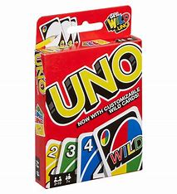
ABOUT UNO CARDS
UNO is a color- and number-matching card game developed in 1971.
Target age: 7+ | Players: 2–10
Known for quick gameplay and universal appeal.
Used for indoor family fun, travel, and parties.

Slide 4
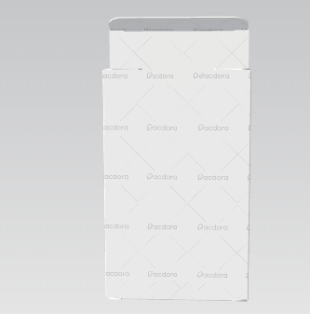
DESIGN CONCEPT
Prioritize user-friendly handling, durability, and brand alignment
Emphasis on a clean layout, UNO logo, and color pops
Concept Keywords: Foldable, Stackable, Sustainable, Bold

Slide 5
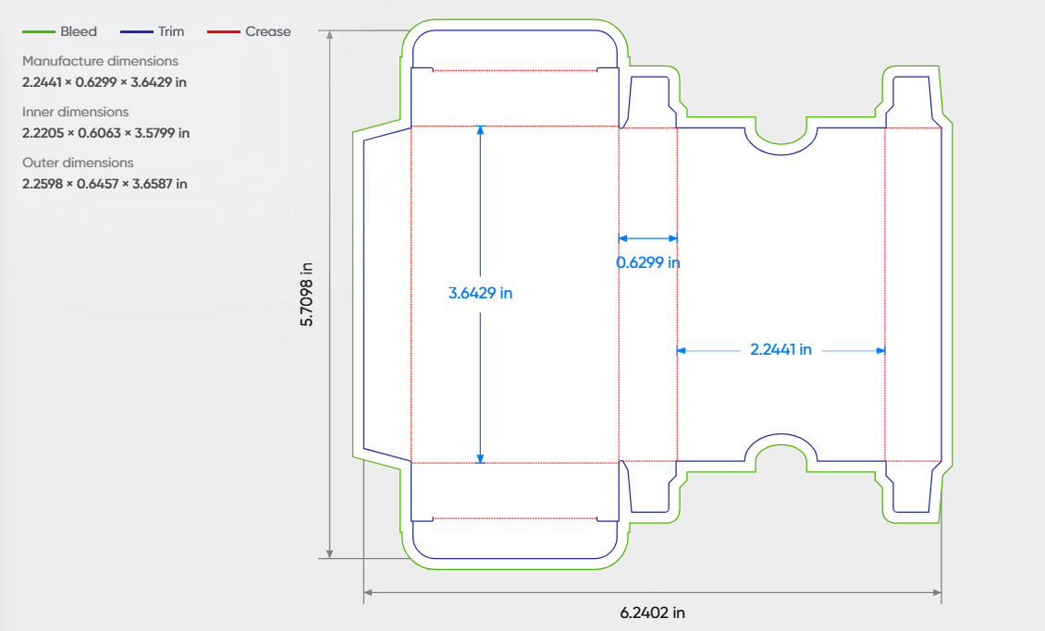
STRUCTURAL DESIGN PAPERBOARD BOX
Type: Flip-top box with tuck-in flap
Material: 300–350 GSM paperboard (durable & recyclable)
Easy open-close mechanism
Fits full UNO deck snugly
Die-cut designed to minimize waste and maximize strength

Slide 6
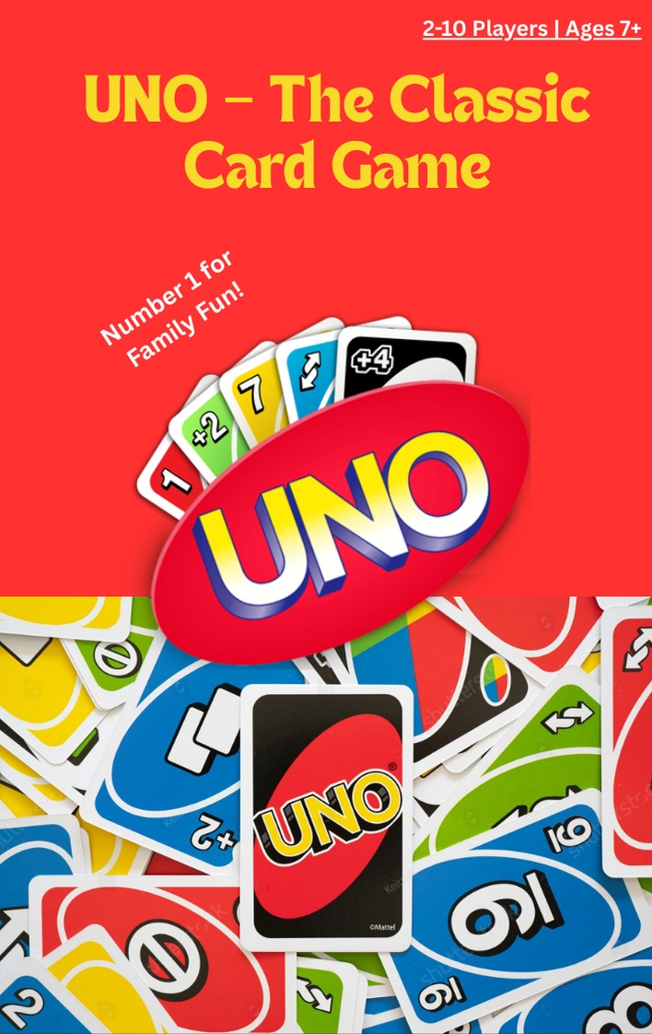
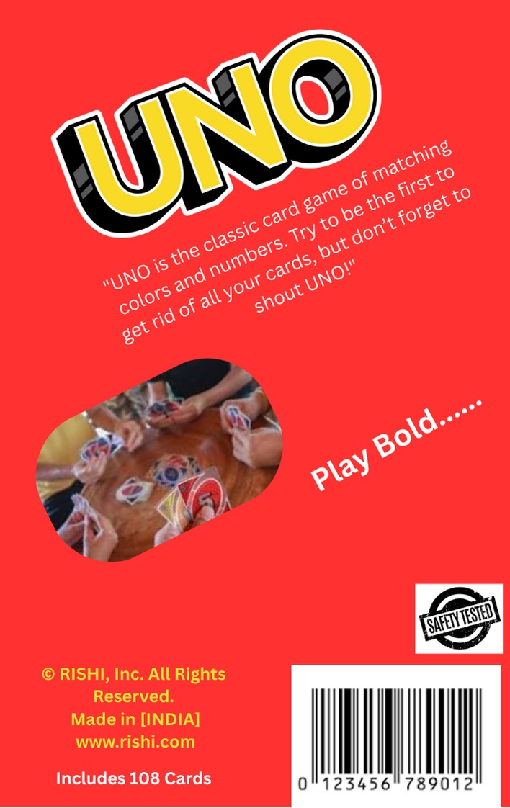
VISUAL DESIGN
Front Side: UNO logo, minimal icons, color blocks
Back Side: Game description, instructions (brief), barcode
Sides: Brand color strips or number icons
Matte finish for a smooth, premium feel
All design done considering digital print on paperboard

Slide 7
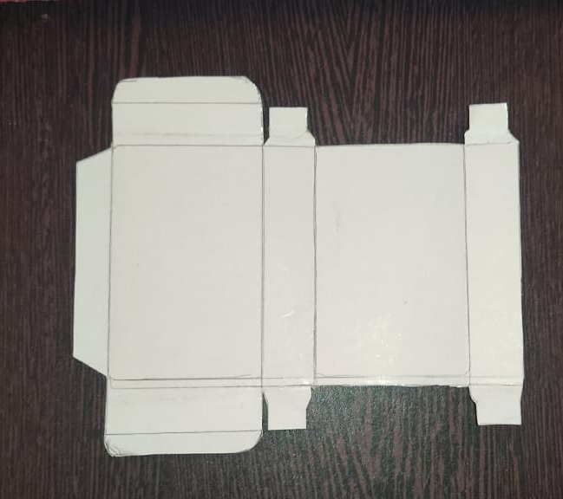
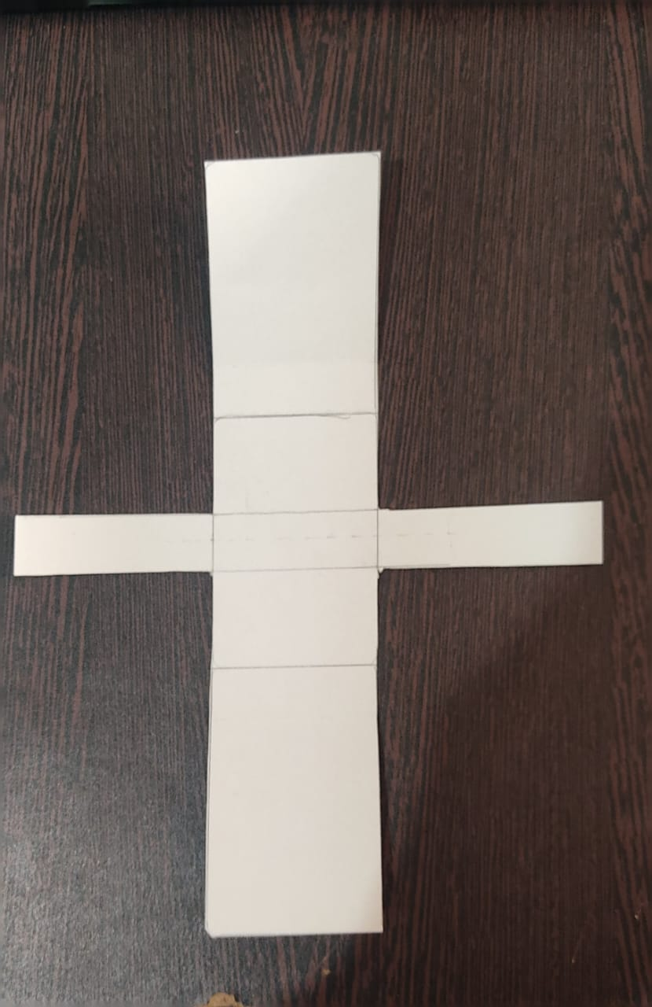
SUSTAINABILITY AND MATERIAL CHOICE
Chose paperboard for:
Lightweight
Recyclability
Easy to print and fold
Avoided plastic/laminate – eco-conscious decision
Minimal use of adhesives

Slide 8
USABILITY & FUNCTIONALITY
Compact design for easy storage and travel
Cards don’t move or scatter inside
Durable paperboard withstands multiple uses
Smooth edges and folds ensure safe handling for kids

Slide 9
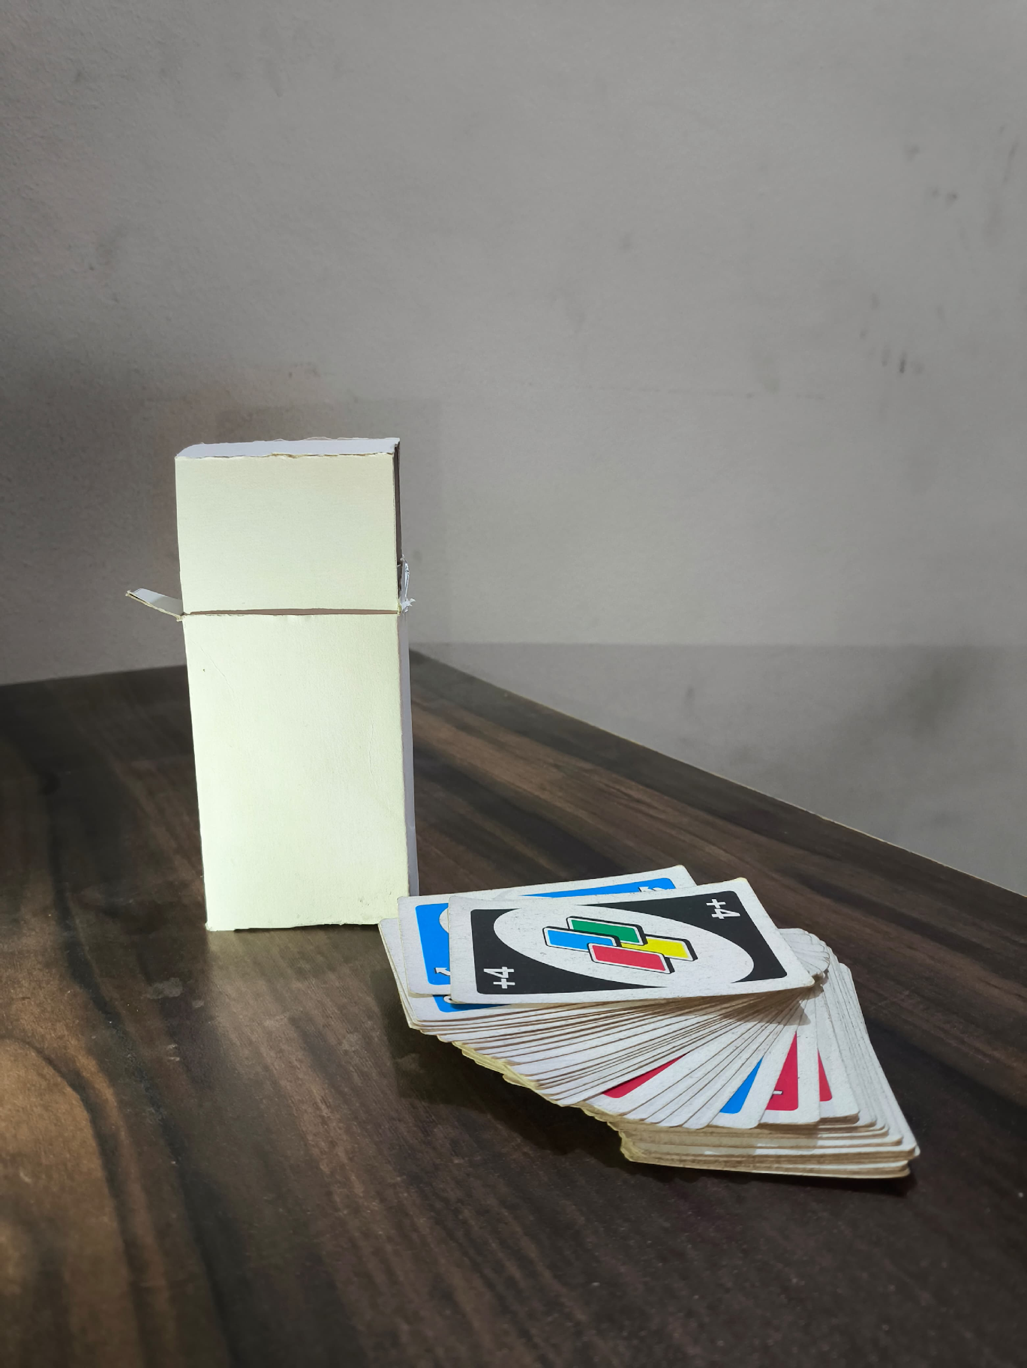
COST & FEASIBILITY
Low-cost material: Paperboard is affordable and easily available
Simple structure: Can be mass produced via die-cut and folding methods
Ideal for local printers or cottage-scale packaging production

Slide 10
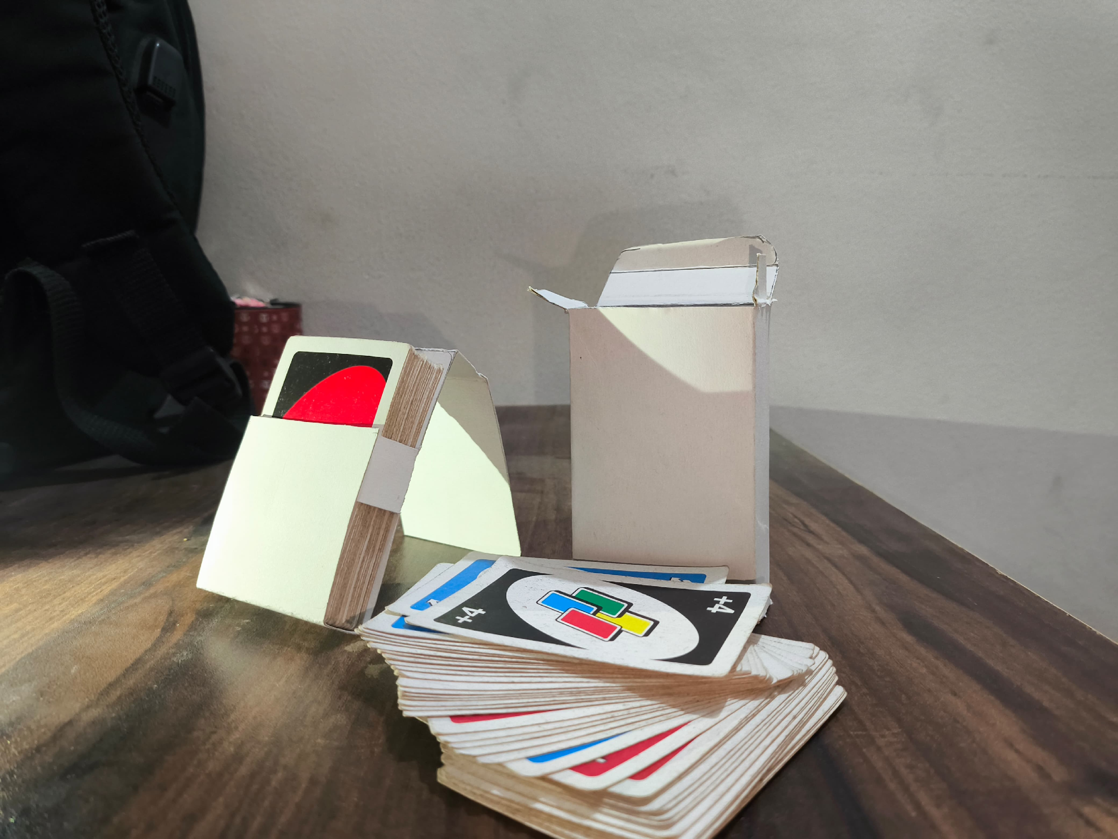
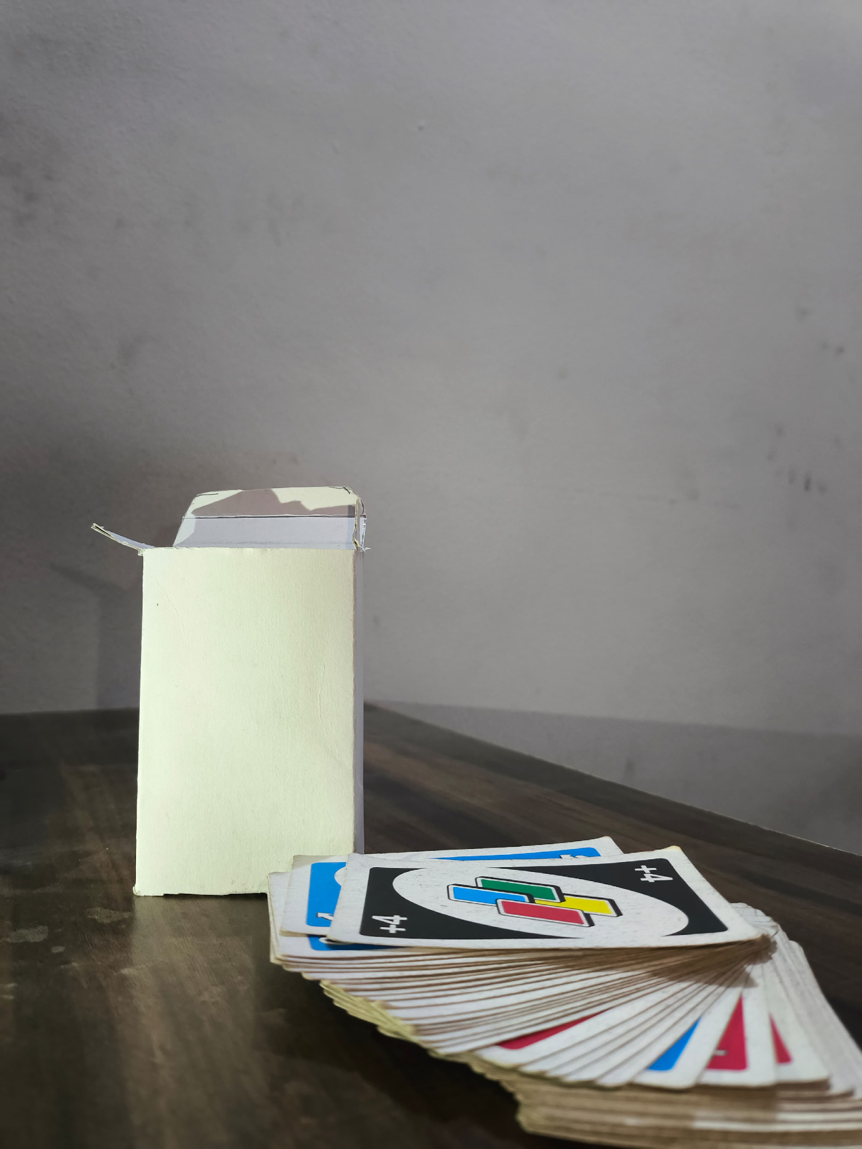
FINAL DESIGN SHOWCASE

Slide 11
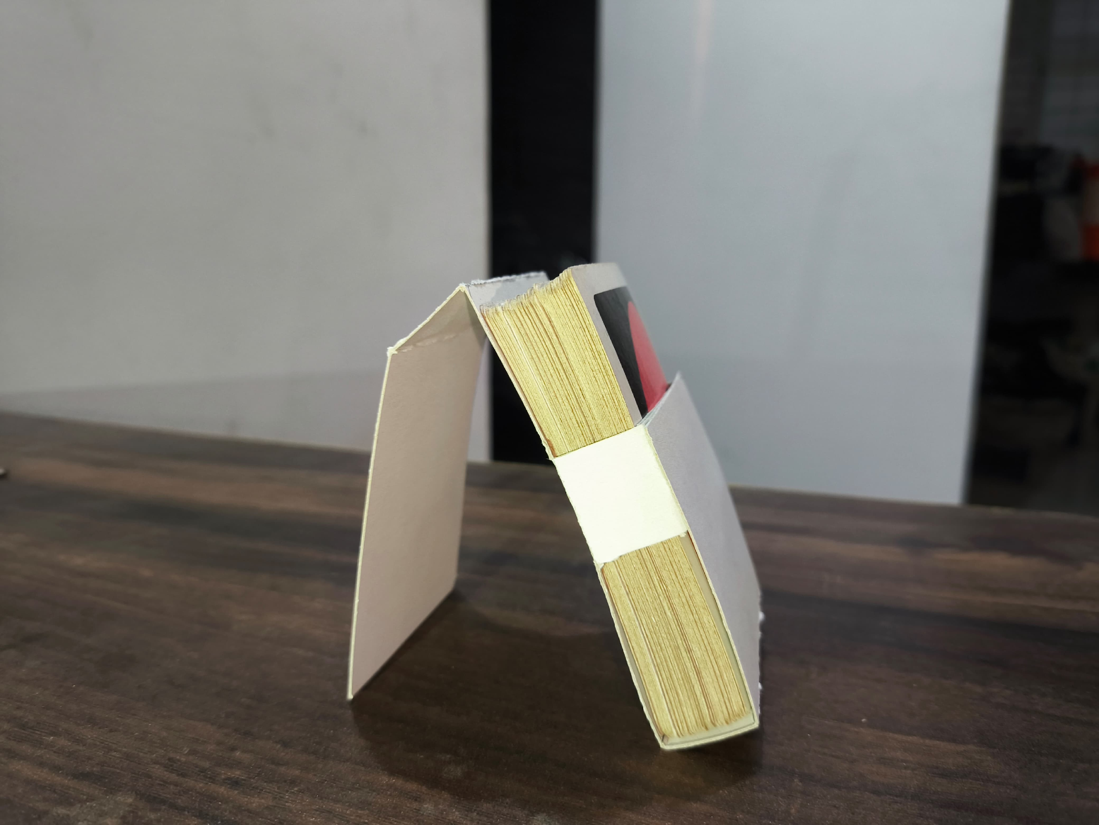
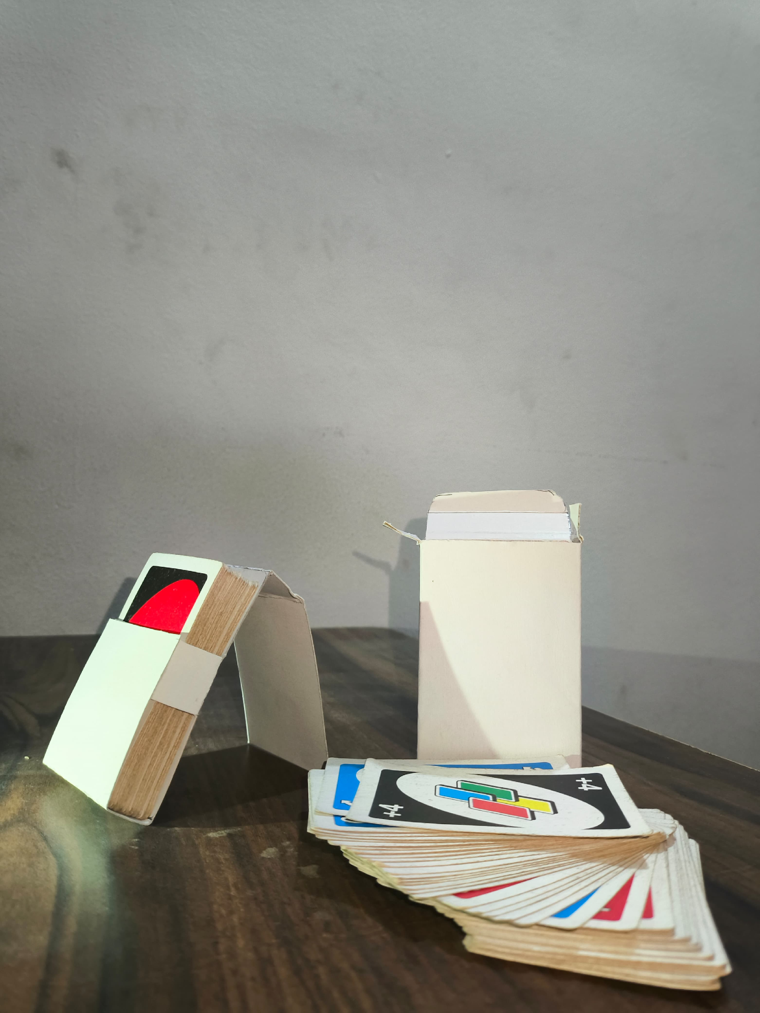
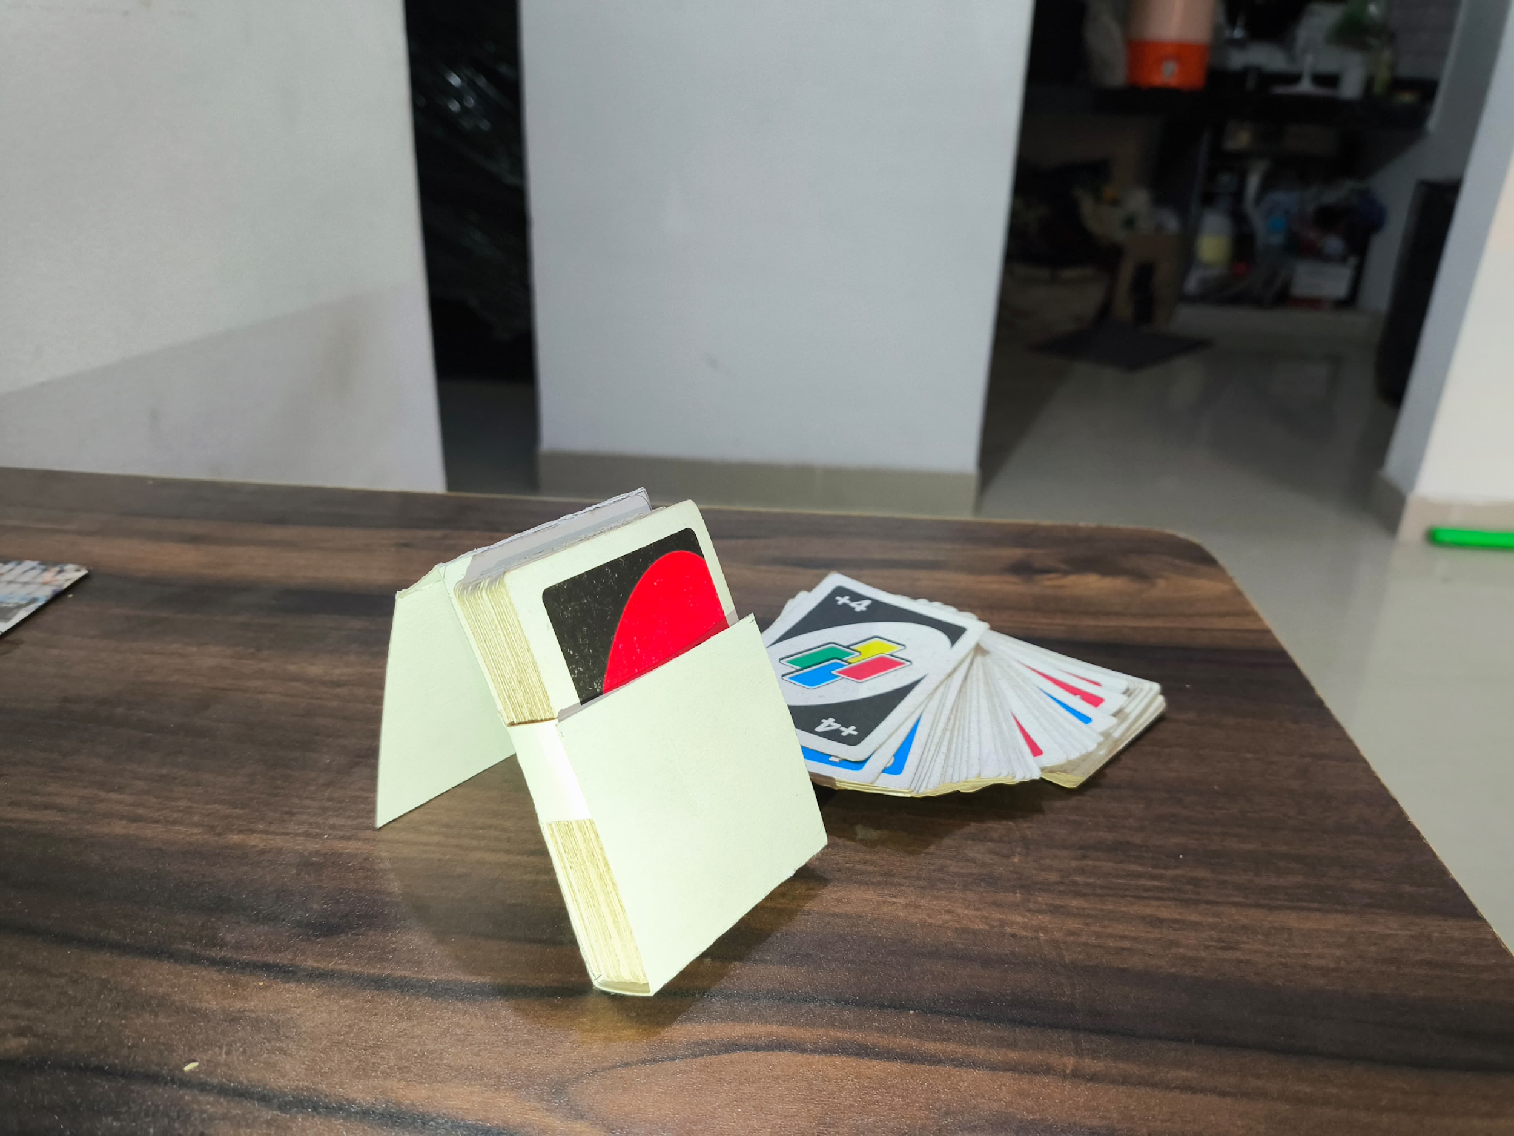

Slide 12
